Slide 1
Physical Activity and Its Impact on
Cardiovascular Disease (CVD) Risk
— A Propensity Score Matching Study
STAT 6230 Causal Inference Final Project
Xue Ming Wang (Vivian)

Slide 2
Cardiovascular Disease Background
Cardiovascular disease (CVD) has emerged as a formidable global health challenge, accounting for a significant portion of morbidity and mortality worldwide.
Understanding its complexity involves exploring various biological, behavioral, and environmental factors.
Notes:
Heart disease is a global health challenge, causing morbidity and mortality worldwide. Understanding its complexity, we need to consider different things like biological, behavioral, and environmental factors.

Slide 3
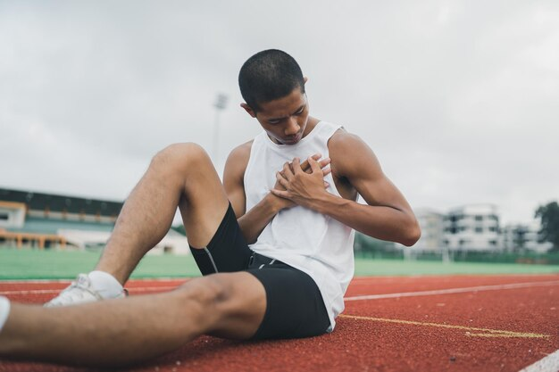
Cardiovascular Disease Background (cont.)
Within this landscape, individuals are paying more attention to how physical activity can affect the chances of getting heart disease.
Aim: Understanding the causal effects of physical activity on CVD risk.
Notes:
In this context, people are paying more attention to how physical activity can affect the chances of getting heart disease. My Goal: Figuring out the causal effects of physical activity on CVD risk.

Slide 4

Literature Review
Mendelian Randomization, Randomized Controlled Trials, propensity score matching method are used for heart disease studies.
Numerous factors were examined in CVD studies:
Unveiled link between bilirubin levels and CVD risk.
Re-evaluated alcohol's impact, challenging presumed cardioprotective role.
Explored educational attainment's complex relationship with CVD.
Notes:
Most studies used Mendelian Randomization, Randomized Controlled Trials, and propensity score matching for CVD. Numerous factors were examined, like the connections between bilirubin levels, alcohol and education level to the risk of heart problems.

Slide 5
Literature Review (cont.)
Exploration of New Links and Influences:
Examined the connection between post-traumatic stress disorder and cardiometabolic diseases.
Explored how vitamin D supplements affect lipid profiles in women, potentially influencing coronary heart disease risk.
Comprehensive Analysis of Heart Failure:
Integrated diverse data sources to understand heart failure with mildly reduced ejection fraction.
Explored epidemiology, clinical features, prognosis, and treatment strategies.
Notes:
Some research looking into new connections like post-traumatic stress disorder and vitamin D supplements affect lipid profiles in women and how they affect CVD. Others explored heart failure, clinical features, prognosis, and treatment strategies.

Slide 6
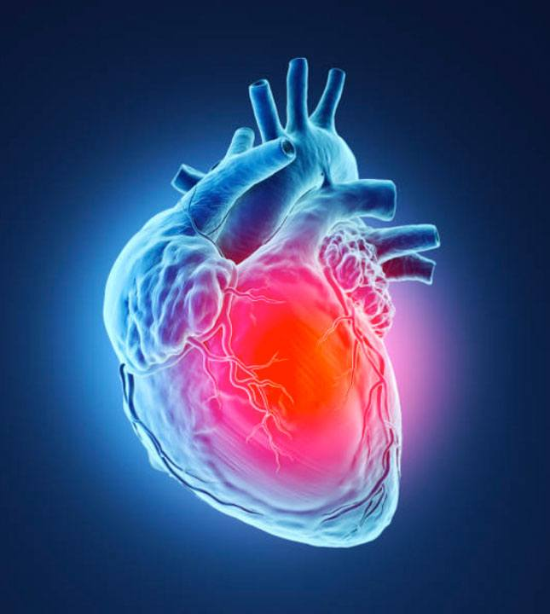
Literature Review (cont.)
Few about physical inactivity:
Cardiovascular Diseases and Ageing in India
Randomized Controlled Trials
Focusing on various demographic and behavioral factors
Reveal 1.7% higher chance of getting diagnosed with heart disease compared to those who are active.
Notes:
I also found a few papers on physical inactivity related to CVD that happened in india focusing on various demographic and behavioral factors. One minor section is about physically inactive shows a 1.7% higher chance of getting diagnosed with heart disease compared to those who are active. So, the author Engaging in light to moderate physical activities significantly impacts CVD risk and overall mortality with CVD. I want to explore more into it.

Slide 7
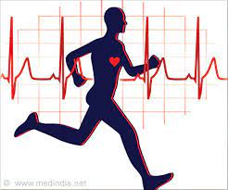
My Research
Goal: Assess the impact of physical activity on cardiovascular disease (CVD) risk in adults to address confounding variables and establish causal relationships.
Research Question: What is the impact of physical activity on the risk of developing cardiovascular disease in adults while adjusting for potential confounders?
Notes:
Building on Existing Knowledge, I want to figure out the impact of physical activity on CVD risk in adults to address confounding variables and establish causal relationships.
So, my Research Question: What is the impact of physical activity on the risk of developing cardiovascular disease in adults while adjusting for potential confounders?

Slide 8
Dataset
Title: Risk Factors for Cardiovascular Heart Disease
Dataset features over 70,000 adults.
Enables exploration of physical activity's independent impact while considering confounding variables.
https://www.kaggle.com/datasets/thedevastator/exploring-risk-factors-for-cardiovascular-diseas
Notes:
From 70,000 adults.

Slide 9
Column name | Description
age | Age of the individual. (Integer)
gender | Gender of the individual. (String)
height | Height of the individual in centimeters. (Int)
weight | Weight of the individual in kilograms. (Integer)
ap_hi | Systolic blood pressure reading. (Integer)
ap_lo | Diastolic blood pressure reading. (Integer)
cholesterol | Cholesterol level of the individual. (Integer)
gluc | Glucose level of the individual. (Integer)
smoke | Smoking status of the individual. (Boolean)
alco | Alcohol consumption status of the individual. (Boolean)
active | Physical activity level. (Boolean) 0 = No,1 = Yes
cardio | Presence or absence of cardiovascular disease. (Boolean) 0 = No,1 = Yes
* Table 1: Risk Factors for Cardiovascular Heart Disease Dataset table from: https://www.kaggle.com/datasets/thedevastator/exploring-risk-factors-for-cardiovascular-diseas

Slide 10

Methods
Estimating Propensity Score
Propensity Score Matching (PSM)
Analyzing Treatment Effects
Checking Balance
T-test
Notes:
Later in detail

Slide 11
Variables
Treatment Assignment: Physically active (active) indicating engagement in physical activity. (0 =No,1 = Yes)
Outcome: Presence or absence of cardiovascular disease (cardio), a binary indicator of diagnosis. (0 =No,1 = Yes)
Confounders: age, gender, weight, blood pressure, cholesterol, glucose, smoking, and alcohol habits.
Notes:
Rest of them are confounders

Slide 12
Estimating Propensity Score
Establishes the relationship between the probability of an individual engaging in a specific level of physical activity (the treatment variable) and a spectrum of observed covariates.
e(xi) =P(Wi=1|Xi)
e(x)=P(active=1∣X)=2.186−0.0036×age+0.0151×gender−0.0026×height−0.003×weight+0.00001×ap_hi+0.0001×ap_lo+0.0681×cholesterol−0.0543×gluc+0.1943×smoke+0.2381×alco.
Notes:
To estimate Propensity Score, I am trying to establishes the relationship between the probability physical activity and covariates. Formula

Slide 13
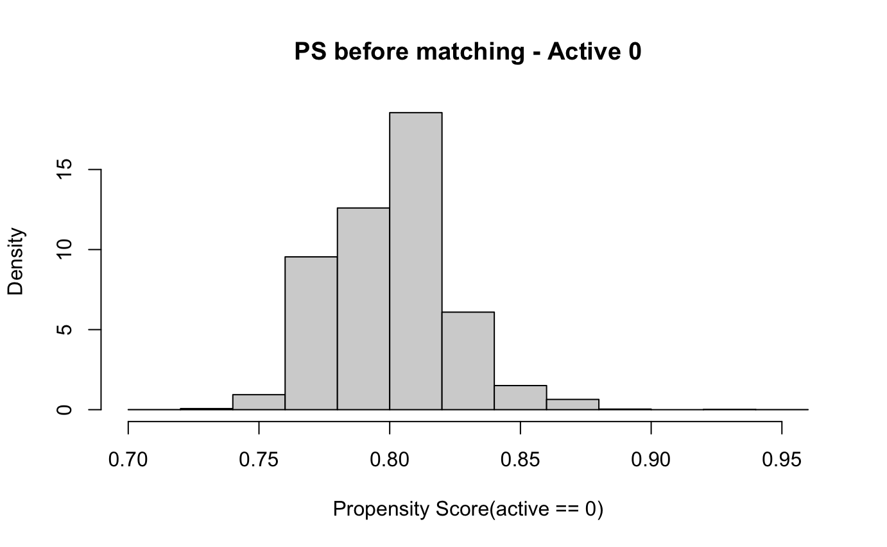
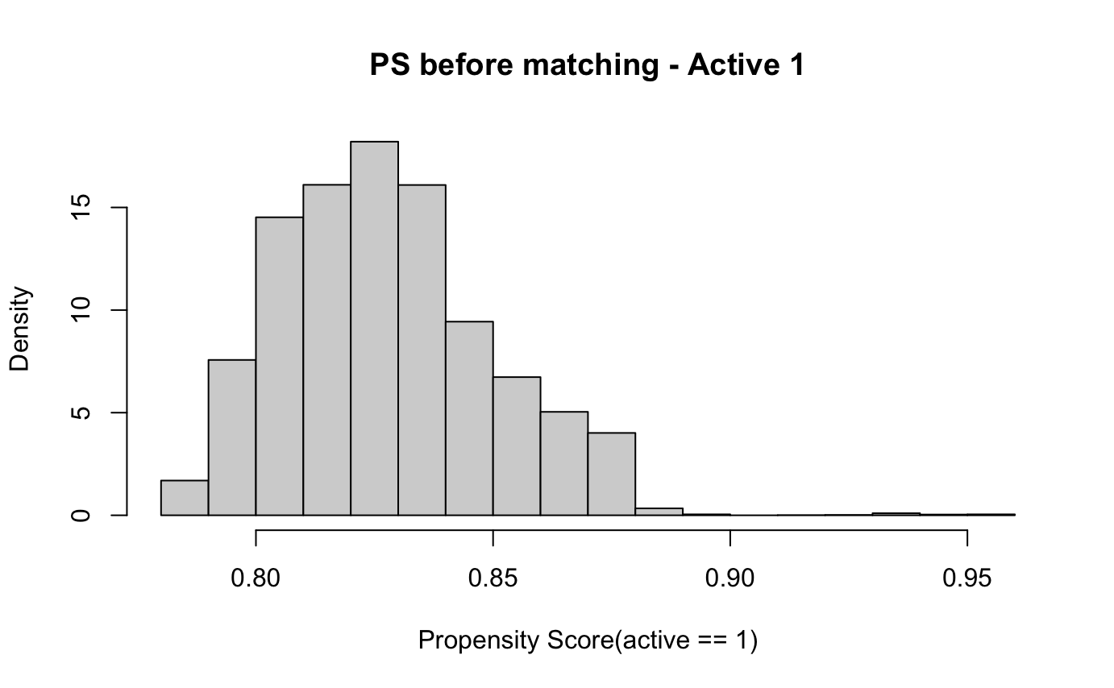

Slide 14

Propensity Score Matching (PSM)
Aim: Create well-balanced treatment (active) and control (inactive) groups based on estimated propensity scores.
First, build logistic regression before matching to be compared with after matching.
Want: reduce bias by ensuring that these groups exhibit similarity in terms of their observed characteristics
Notes:
Next come to the Propensity Score Matching PSM: Create well-balanced treatment (active) and control (inactive) groups based on estimated propensity scores. First, I build logistic regression before matching to be compared with after matching.

Slide 15
Propensity Score Matching (PSM)
A matchit object:
Method: 1:1 nearest neighbor matching without replacement
Distance: Propensity score - estimated with logistic regression
Number of obs.: 1399 (original), 548 (matched)
Target estimand: ATT
Covariates: age, gender, height, weight, ap_hi, ap_lo, cholesterol, gluc, smoke, alco
Notes:
based on the distance measured through propensity scores estimated using logistic regression.

Slide 16
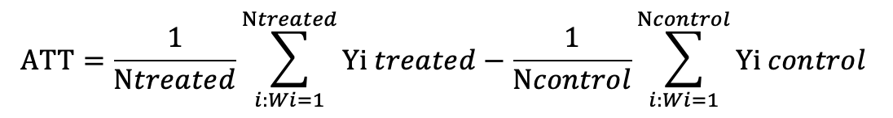
Average Treatment Effects on the Treated
Compare the treated and control groups after matching.
Average effect of increased physical activity on reducing the risk of CVD in treated individuals, with adjusted confounders.
ATT = average outcome of active group - average outcome of the inactive group.
ATT = E[Yi(1)-Yi(0)|Wi=1]
Notes:
Compare the treated and control groups after matching.
Average effect of increased physical activity on reducing the risk of CVD in treated individuals
average outcome of treated group - average outcome of the control group.
It is the average effect of increased physical activity on reducing the risk of CVD among the treated individuals, considering the adjustment for various confounding factors through propensity score matching.

Slide 17
Average Treatment Effects on the Treated
 | ATT | SE | 25% CI | 75% CI | P-Value | Significant or Not
GLM Before | 0.0059 | 0.0299 | -0.0528 | 0.0646 | 0.8429 | No
PSM | 0.3139 | 0.0576 | 0.2394 | 0.3883 | 4.9030e-15 | Yes
GLM After | 0.1422 | 0.0576 | 0.0294 | 0.2550 | 1.3795e-02 | Yes
=> Physical activity would lower CVD risk

Slide 18
Checking Balance
Standardized Mean Differences (SMD)
Assess the balance achieved in covariates between treated (active = 1) and control groups (active =0).
See the similarity of the distributions of covariates.
Threshold: SMD less than 0.1 and close to 0.

Slide 19
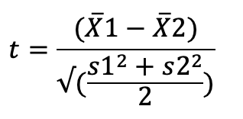
SMD Formula
Where:
X1-bar and X2-bar are the means of the two groups being compared.
s1 and s2 ​are the standard deviations of the two groups.

Slide 20
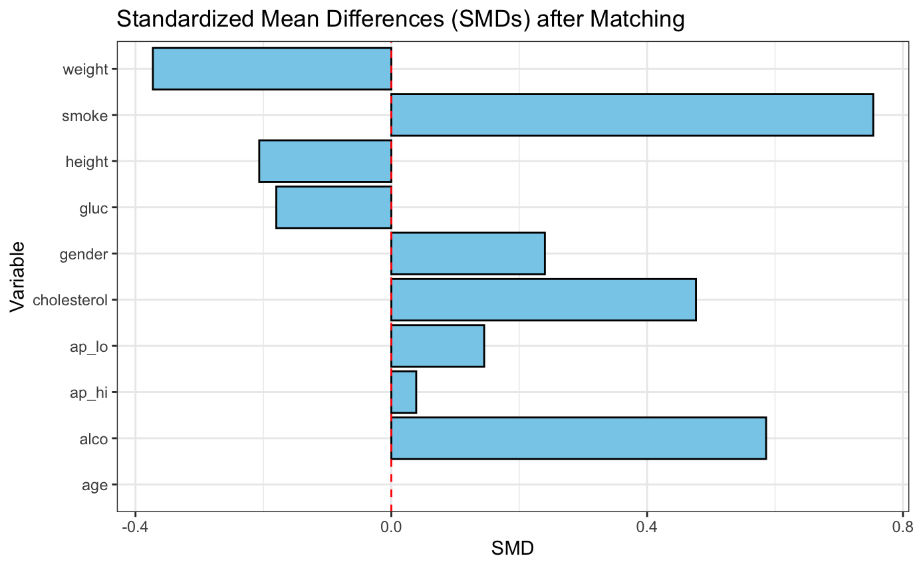

Slide 21
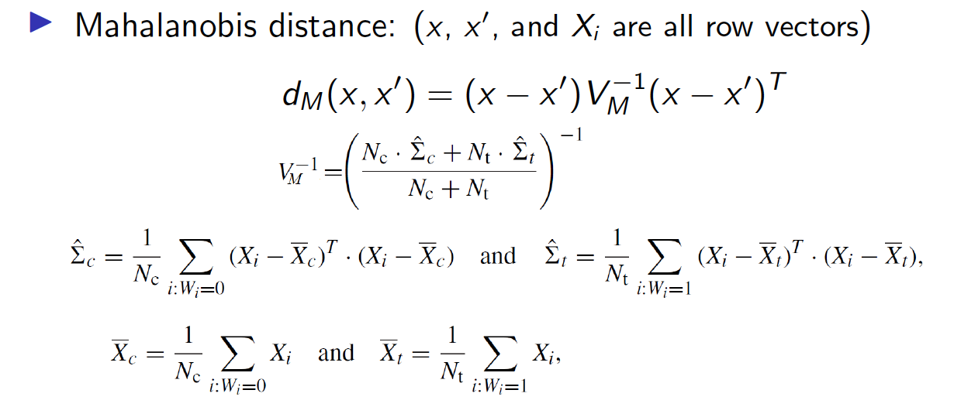
Mahalanobis Distance Metric
*Lecture 8 Slide 11 from Professor Subrata Kundu

Slide 22

Mahalanobis Distance Metric
A measure used to determine the similarity or dissimilarity between two data points in a multidimensional space.
Split to two stratified groups: 0 (inactive) and 1 (active).
Look for similarity in covariate patterns and propensity scores between the active and inactive groups.

Slide 23
Mahalanobis Distance Metric
Similarities: age (0.271), gender (0.121), height (0.051), blood pressure(0.737/0.368), smoking (0.059), cholesterol and alcohol(0.667)
No significant differences between active/inactive groups
Dissimilarities: weight (<0.001) and glucose levels (0.023)
Significant differences between active/inactive groups
*(number)= P-Value

Slide 24
Checking Balance with SMD
Variables | SMD Value | Balance/Not Balanced
age | 0.00320 | Balanced
gender | 0.07037 | Balanced
height | -0.08148 | Balanced
weight | -0.48622 | Not Balanced
ap_hi | 0.00268 | Balanced
ap_lo | 0.05197 | Balanced
cholesterol | 0.09356 | Balanced
gluc | -0.05580 | Balanced
smoke | 0.39559 | Not Balanced
alco | 0.09298 | Balanced

Slide 25
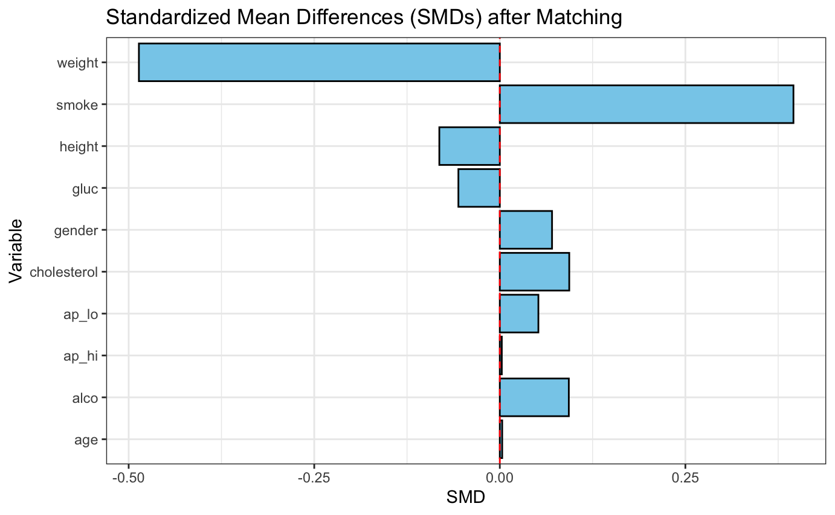
Checking Balance
Notes:
The comparison involves evaluating the distributions of covariates before and after matching by analyzing standardized mean differences or other balance metrics across both treated and control groups.

Slide 26

ATT
ATT(Active=1) : 0.1605
SE: 0.0037
CI: (0.153 to 0.168)
P-Value: <2e-16
==> Significantly associated with CVD risk

Slide 27
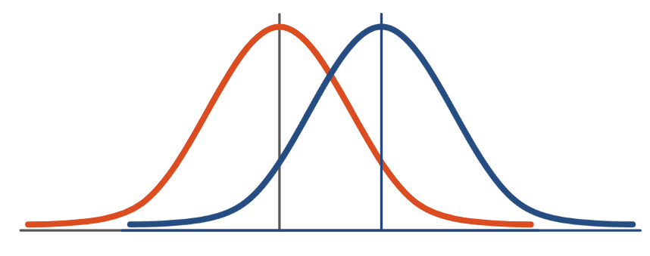
T-Test
Comparison of Active vs. Inactive Groups
Paired t-test using matched dataset
Null hypothesis: There is no difference in mean CVD risk between individuals who are physically active and those who are inactive.
Alternative hypothesis: There is difference in mean CVD risk between individuals who are physically active and those who are inactive. (true difference in means between active and cardio is not equal to 0)

Slide 28
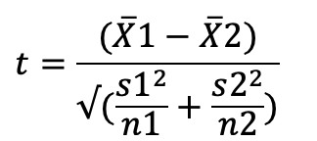
T-Test Formula
Where:
X1-bar is the mean CVD risk in the active group.
X2-bar is the mean CVD risk in the inactive group.
s is standard deviation of differences between paired observations.
n is the number of pairs (or individuals) in the matched dataset.

Slide 29
T-test
T-value: -8.0752
P-value: 2.173e-14 (statistically significant) → difference in active/inactive
95% CI for mean difference: (-0.390, -0.237)
Estimated Mean Difference: -0.313 → substantial reduction in CVD risk
==> Potential CVD risk reduction through engagement in physical activity

Slide 30
Further Research and Limitations
Further Research
Sensitivity analysis
Other matching methods
Larger sample size
Limitations
Matching might not completely eliminate all sources of bias
Physical activity depends on overall health conditions

Slide 31

Conclusion
Physical activity significantly reduces cardiovascular disease risk in adults while adjusting for confounders.
Increased physical activity correlates with a lowered risk of developing cardiovascular disease.
Engaging in physical activity plays a vital role in mitigating the risk of heart-related issues in adults.
Notes:
Mahalanobis distance analysis helps us understand things better than the usual matching methods.

Slide 32
References
B G, Sujata S, Thakur R. (2023). Cardiovascular Diseases and Ageing in India: A Propensity Score Matching Analysis of the Effects of Various Risk Factors. Current Problems in Cardiology, 48(5), 101606. doi:10.1016/j.cpcardiol.2023.101606. Epub 2023 Jan 20. PMID: 36682392.
Dempsy, K. (2023, January 12). Dataset: Risk factors for cardiovascular heart disease. Kaggle. https://www.kaggle.com/datasets/thedevastator/exploring-risk-factors-for-cardiovascular-diseas
Hamad, R., Nguyen, T. T., Bhattacharya, J., Glymour, M. M., & Rehkopf, D. H. (2019). Educational attainment and cardiovascular disease in the United States: A quasi-experimental instrumental variables analysis. PLoS Medicine, 16(6), e1002834. doi:10.1371/journal.pmed.1002834. PMID: 31237869; PMCID: PMC6592509.
Koenen, K., Sumner, J., Gilsanz, P., Glymour, M., Ratanatharathorn, A., Rimm, E., ... Kubzansky, L. (2017). Post-traumatic stress disorder and cardiometabolic disease: Improving causal inference to inform practice. Psychological Medicine, 47(2), 209-225. doi:10.1017/S0033291716002294.
Kyu, H. H., Bachman, V. F., Alexander, L. T., Mumford, J. E., Afshin, A., Estep, K., ... Forouzanfar, M. H. (2016). Physical activity and risk of breast cancer, colon cancer, diabetes, ischemic heart disease, and ischemic stroke events: systematic review and dose-response meta-analysis for the Global Burden of Disease Study 2013. BMJ, 354, i3857. doi:10.1136/bmj.i3857. PMID: 27510511; PMCID: PMC4979358.
McArdle, P.F., Whitcomb, B.W., Tanner, K., et al. (2012). Association between bilirubin and cardiovascular disease risk factors: Using Mendelian randomization to assess causal inference. BMC Cardiovascular Disorders, 12(1), 16. doi:10.1186/1471-2261-12-16.
Nüesch, E., Dale, C., Palmer, T. M., White, J., Keating, B. J., van Iperen, E. P., ... Casas, J. P. (2016). Adult height, coronary heart disease and stroke: a multi-locus Mendelian randomization meta-analysis. International Journal of Epidemiology, 45(6), 1927-1937. doi:10.1093/ije/dyv074. PMID: 25979724; PMCID: PMC5841831.
Rosoff, D. B., Smith, G. D., Mehta, N., Clarke, T. K., & Lohoff, F. W. (2020). Evaluating the relationship between alcohol consumption, tobacco use, and cardiovascular disease: A multivariable Mendelian randomization study. PLoS Medicine, 17(12), e1003410. doi:10.1371/journal.pmed.1003410. PMID: 33275596; PMCID: PMC7717538.
Savarese, G., Stolfo, D., Sinagra, G., & Lund, L. H. (2022). Heart failure with mid-range or mildly reduced ejection fraction. Nature Reviews Cardiology, 19(2), 100-116. doi:10.1038/s41569-021-00605-5. Epub 2021 Sep 6. PMID: 34489589; PMCID: PMC8420965.
Smith, G. D., Timpson, N., & Ebrahim, S. (2008). Strengthening causal inference in cardiovascular epidemiology through Mendelian randomization. Annals of Medicine, 40(7), 524-541. doi:10.1080/07853890802010709.
Wang, K., Shi, X., Zhu, Z., Hao, X., Chen, L., Cheng, S., Foo, R. S. Y., & Wang, C. (2022). Mendelian randomization analysis of 37 clinical factors and coronary artery disease in East Asian and European populations. Genome Medicine, 14(1), 63. doi:10.1186/s13073-022-01067-1. PMID: 35698167; PMCID: PMC9195360.
Zhang, W., Yi, J., Liu, D., Wang Y., Jamilian P., Gaman MA, Prabahar K, Fan J. (2022). The effect of vitamin D on the lipid profile as a risk factor for coronary heart disease in postmenopausal women: a meta-analysis and systematic review of randomized controlled trials. Experimental Gerontology, 161, 111709. doi:10.1016/j.exger.2022.111709. Epub 2022 Jan 26. PMID: 35090975.

